Slide 1


Pavan Sai | B.E. CSE (AI & DS)
AI Bookkeeping
Dashboard
Traditional Bookkeeping vs AI Bookkeeping
Presented By:
Pavan Sai
Student Hackathon Project

Slide 2




AI Bookkeeping Dashboard
Problem Statement
Manual Processes
Time-consuming data entry and reconciliation tasks drain productivity and delay financial reporting cycles.
Human Errors
Traditional bookkeeping is manual, time-consuming, and prone to costly errors.
Prone to mistakes and oversight that lead to inaccurate records, compliance issues, and financial discrepancies.
Manual data entry processes consume significant time and resources. Human oversight leads to errors in financial records that compound over time. Duplicate and suspicious transactions frequently slip through undetected. These inefficiencies make bookkeeping difficult for students, individuals, and small businesses.
Missed Fraud
Duplicate and suspicious transactions often go undetected, exposing businesses to financial risk and loss.

Slide 3
AI Bookkeeping Dashboard
Why This Project Matters for Students
• Students manage pocket money and monthly expenses
• Difficult to track spending manually
• Duplicate entries can create confusion
• AI can help identify unusual spending patterns
• Encourages financial awareness and budgeting

Slide 4




AI Bookkeeping Dashboard
Project Objective
Improve Accuracy
Reduce Manual Effort
Detect Suspicious Activity
Leverage AI assistance to significantly enhance bookkeeping accuracy, minimizing human errors and ensuring reliable financial records through intelligent data validation and automated cross-checking.
Streamline bookkeeping workflows by automating repetitive tasks, dramatically cutting processing time and freeing up resources for higher-value financial analysis and decision-making.
Effectively identify duplicate entries and suspicious transactions through rule –based AI analysis, providing risk classification and early warning alerts to prevent fraud.

Slide 5









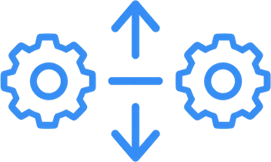








AI Bookkeeping Dashboard
Technologies Used
The core tools and frameworks powering our AI Bookkeeping Dashboard project.

Slide 6

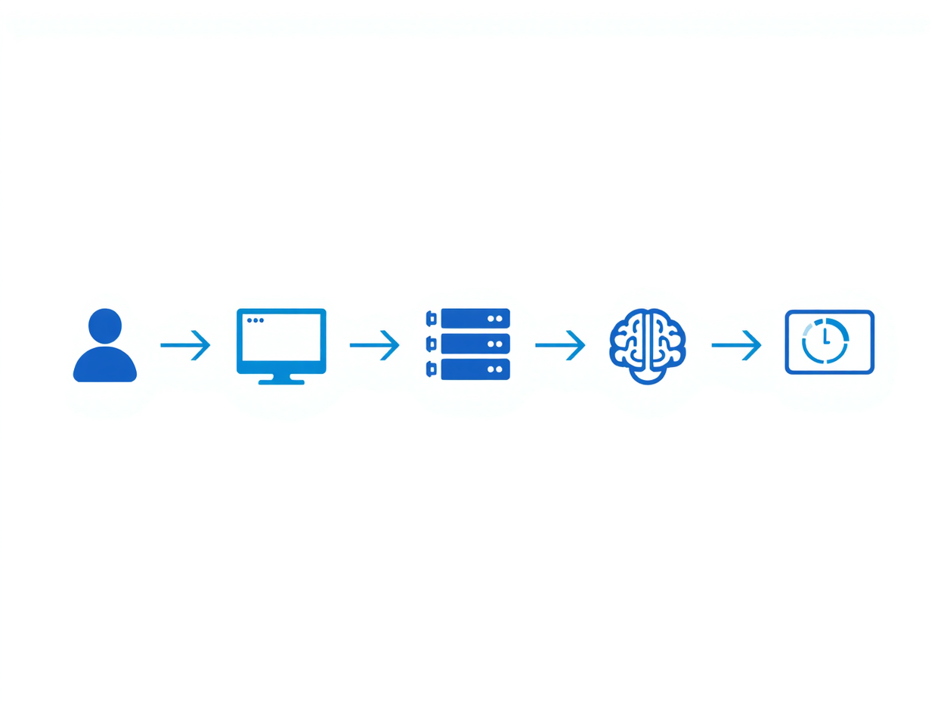



AI Bookkeeping Dashboard
System Workflow
User inputs transactions in React frontend
Data sent via REST API to Flask backend
AI engine analyzes for duplicates & risk
Risk classifications and summary results returned to dashboard.
Complete flow: User → Frontend → Backend → AI Engine → Dashboard

Slide 7

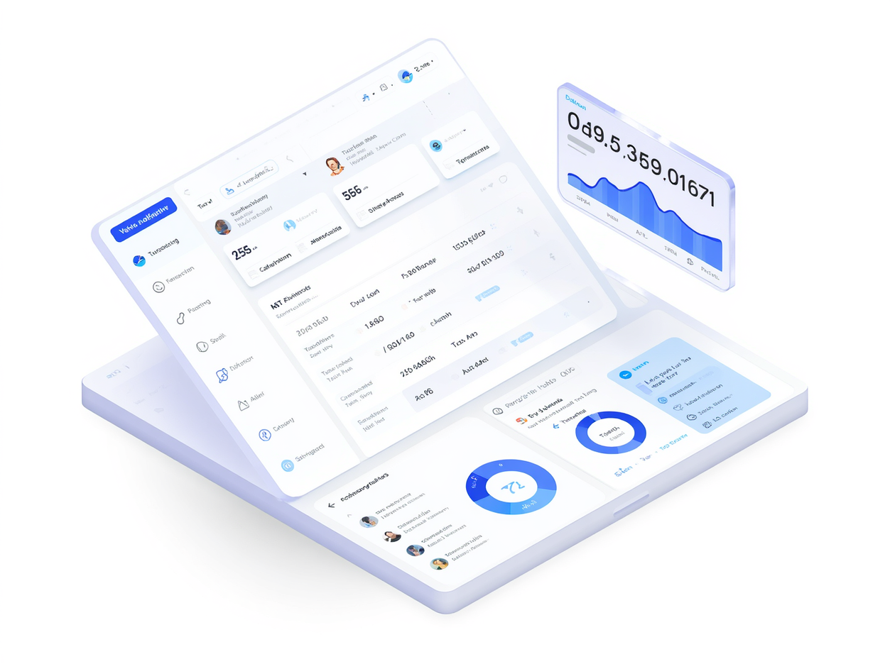



AI Bookkeeping Dashboard
Key Features
Transaction entry and management
Duplicate transaction detection
High-value transaction detection
Risk score calculation with Safe, Warning, and High Risk classifications. Dashboard summary with real-time alerts and actionable insights.

Slide 8


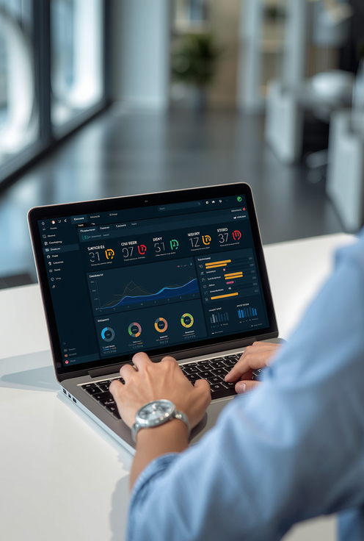


AI Bookkeeping Dashboard
Demo Flow
Step 1: Normal Entry
Enter standard transactions through the React frontend. The AI engine analyzes and classifies them as SAFE with low risk scores.
Step 2: Duplicate Detection
See how the AI bookkeeping system classifies transactions in real-time.
Submit duplicate transaction entries. The system automatically detects matches and generates WARNING alerts on the dashboard.
The demo showcases three key scenarios: entering normal transactions that get classified as SAFE, submitting duplicate entries that trigger WARNING alerts, and inputting high-value suspicious transactions that are flagged as HIGH RISK. All results display live on the dashboard with calculated risk scores.
Step 3: High Risk Flag
Input high-value or suspicious transactions. These are immediately flagged as HIGH RISK with elevated scores and prominent alerts.

Slide 9

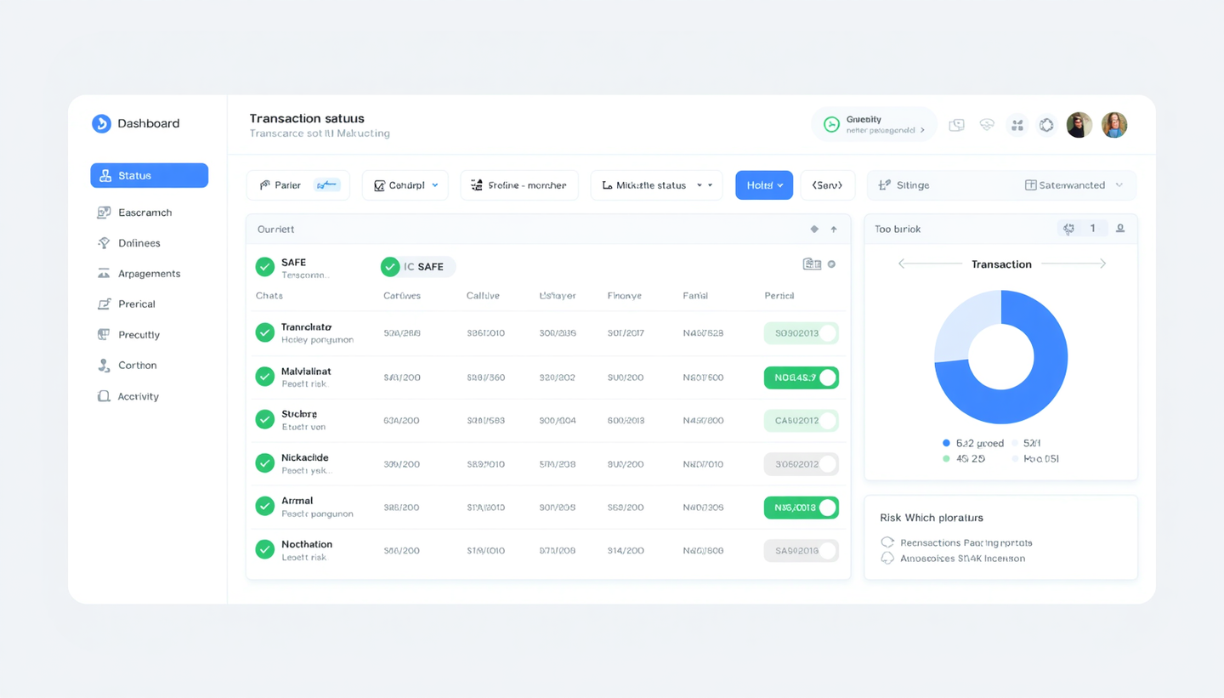
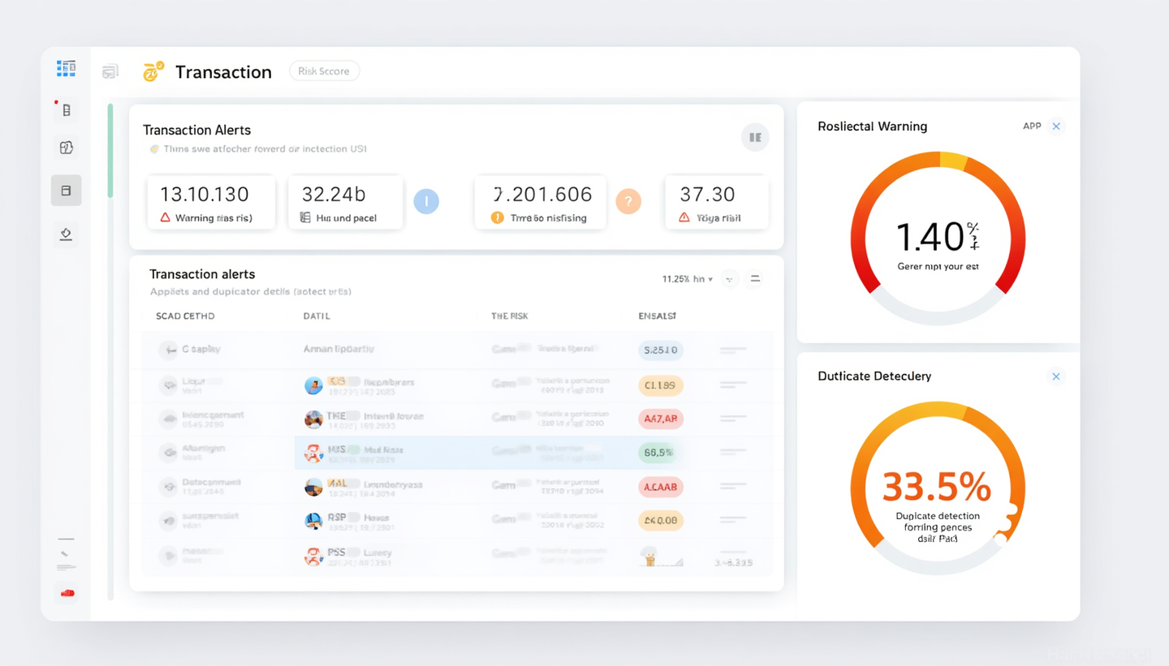
AI Bookkeeping Dashboard
Results and Dashboard Screenshots
Three dashboard views demonstrate the AI classification system in action. The SAFE scenario shows normal transactions with green indicators and low risk scores. The WARNING view highlights duplicate detection with amber alerts and elevated risk classifications. The HIGH RISK display flags suspicious high-value transactions with red warnings and maximum risk scores, enabling immediate review.

Slide 10




AI Bookkeeping Dashboard
Future Scope
Database Integration
ML Fraud Detection
Automated Reporting
Implement SQLite database for persistent transaction storage, enabling historical data analysis and audit trails. This foundation supports scalable data management and seamless backup capabilities for enterprise deployment.
Integrate machine learning models for advanced fraud detection beyond rule-based analysis. Future versions can be trained on real banking datasets to identify complex patterns and anomalies that traditional methods miss.
Generate automated PDF reports for financial summaries and compliance documentation. Incorporate real banking datasets for validation, ensuring robustness and accuracy in production environments.

Slide 11




AI Bookkeeping Dashboard
Conclusion
Reduced Manual Workload
Improved Accuracy & Speed
Early Risk Detection
AI-assisted bookkeeping significantly reduces manual effort, freeing up valuable time for higher-value tasks. Automated transaction processing eliminates repetitive data entry and verification work.
Machine-powered analysis ensures consistent, error-free transaction processing at scale. Processing time is dramatically reduced while maintaining high accuracy standards throughout.
Suspicious and duplicate transactions are identified immediately through intelligent pattern recognition. The dashboard provides actionable financial insights and risk classifications for informed decision-making.

Slide 12


AI Bookkeeping Dashboard
Thank You
Questions & Discussion
Pavan Sai - B.E. CSE (AI & DS)
Student Hackathon Project 2024
Thank you for your attention!

